Slide 1
Bones, Muscles and Skin
Performance Task

Slide 2
The Doctors are in!
The doctors are in! You are a young doctor invited to present at the school health fair. You will be teaching third graders at an elementary school about bones, muscles, and skin. Your job is to help students understand why these systems are essential for life.

Slide 3
Situation
Yates Mill’s Fun Run is next week, and we need to make sure everyone knows how the skeletal system, muscular system, and the skin work together to keep our bodies alive.
We also want to help students live healthier lives by staying healthy and keeping their bodies strong and in shape.

Slide 4
Your job is to explain to students the main function of each system and describe how the three systems work together to prepare their bodies for the race. You will develop a visual representation of each system by explaining how the skeleton and muscle systems, as well as skin, depend on each other. In addition, you will explain ways students can keep each body system healthy so that they can be prepared for the race.
Your presentation should be visually appealing to get the students interested in your project.
You could even include directions to an excersise to help get the students interested.
Make sure to use specific vocabulary to demonstrate clear your background knowledge on this topic.

Slide 5
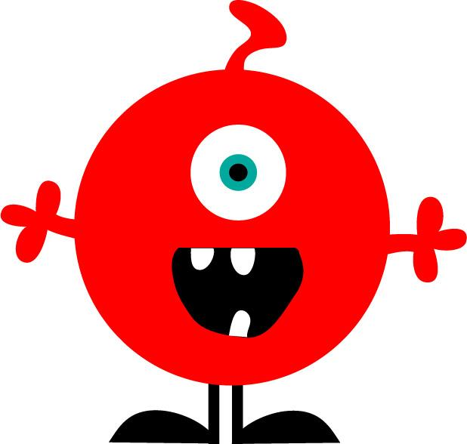
Your main goal is to help students understand how the skeletal and muscular system along with skin are interrelated and the importance of these systems that provide support, protection, and allow your body to move.
Visual Representation: must include bones, muscles, and skin all labeled.
use clear vocabulary
Think of ways to improve the health of kids and give them suggestions on ways to stay healthy.
Make sure to inlcude how body systems offer movement, support and protection.
Work as a team to decide on what your jobs and roles will be within the group.
The Product

Slide 6
Make sure your visual model describes bones, muscles, and skin.
Label each part of your diagram
Include the following vocabulary in your visual:
Bones (skeletal system)
Muscle (muscular system)
Skin
Function
Human body systems
Support
Protection
Movement
Essential for life
The Criteria

Slide 7
Resources for you!
All about Skin!
All about Muscles!
WATCH IT
All about Bones!

